Slide 1

WORD PROBLEMS ON ADDITION
kidslearnwithconcept.in

Slide 2
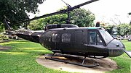
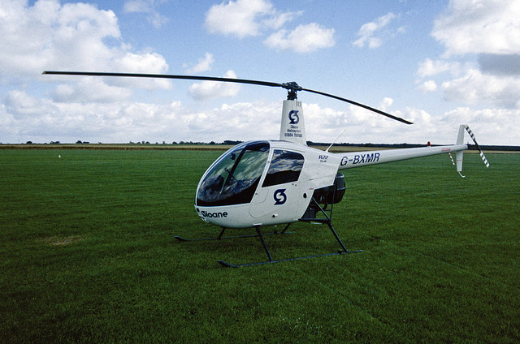
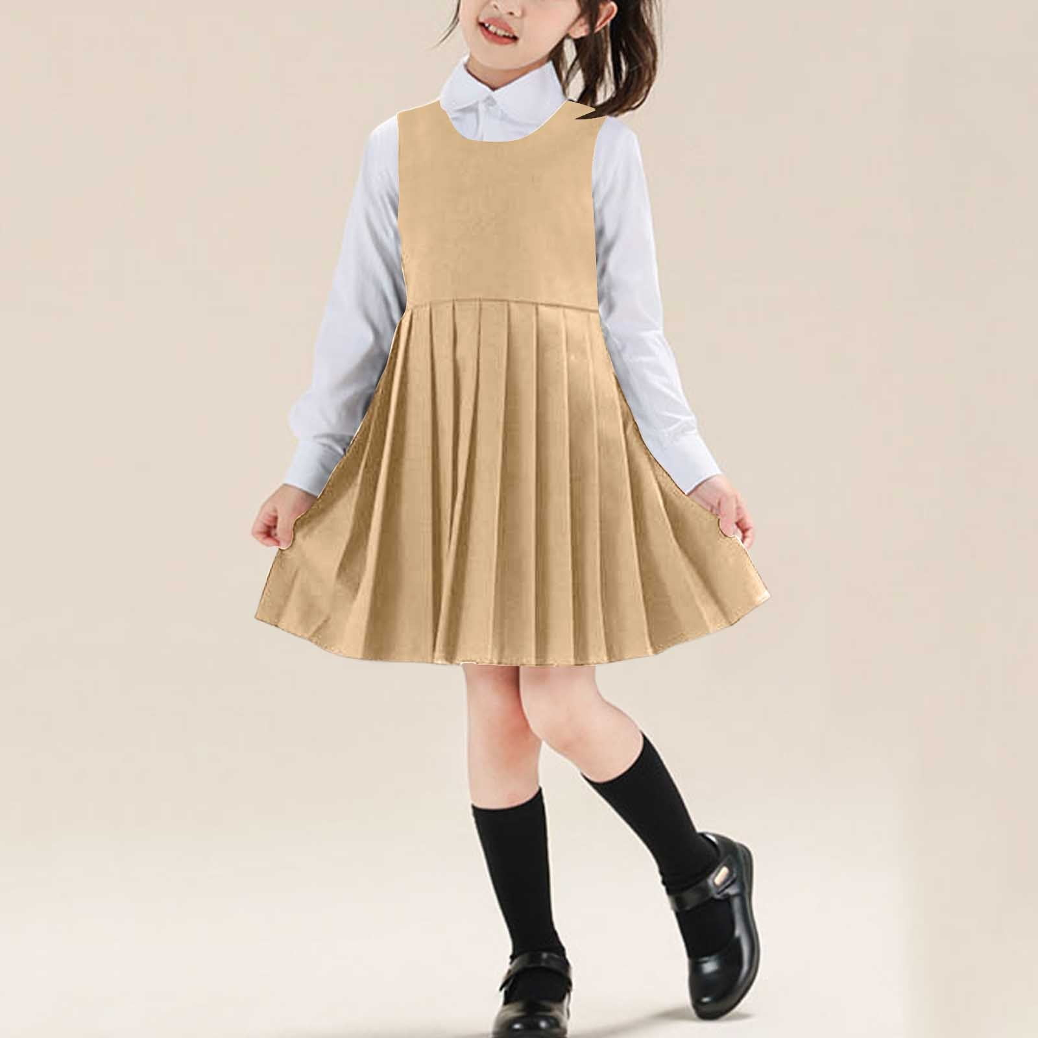
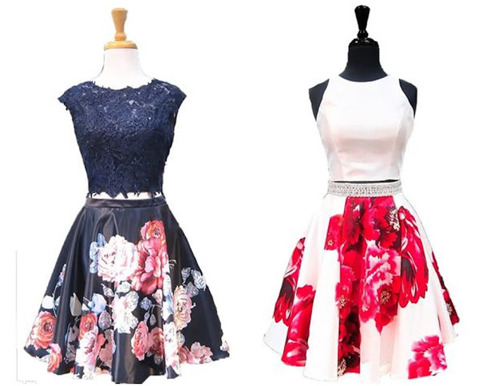
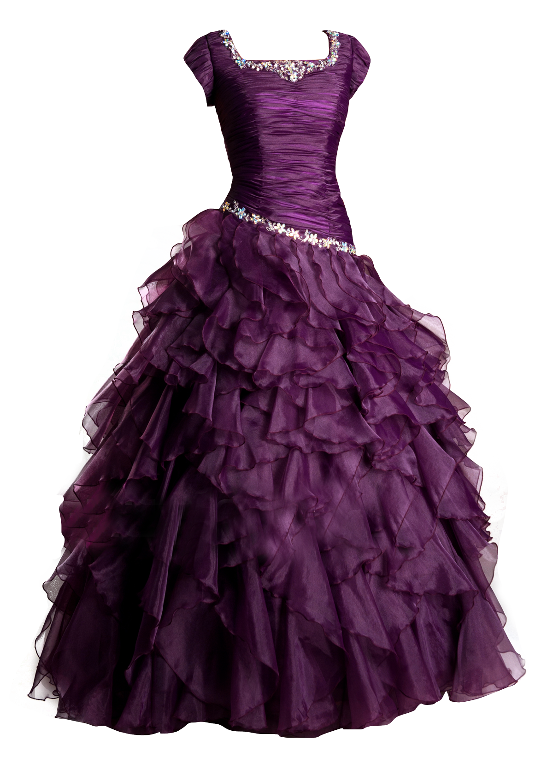
1 helicopter was on the ground .1 more helicopter came down. How many helicopter are there on the ground now ?
2. Mother gave 1 dress to Lata .Father gave her 2 dresses. How many dresses did Lata get ?
kidslearnwithconcept.in

