Slide 1

Phonic sound
kidslearnwithconcept.in

Slide 2

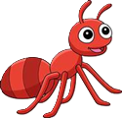
A – ऐ
Ant
Axe
kidslearnwithconcept.in

Slide 3


B – ब
Bat
Bell
kidslearnwithconcept.in

Slide 4


C – क
Cup
Cat
kidslearnwithconcept.in
Cat

Slide 5


D – ड
Dog
Doll
kidslearnwithconcept.in

Slide 6

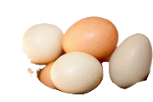
E – ए
Egg
End
kidslearnwithconcept.in

Slide 7

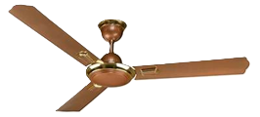
F – फ
Fan
Fat
kidslearnwithconcept.in

Slide 8


G – ग
Gun
Gap
kidslearnwithconcept.in

Slide 9


H – ह
Hen
Hat
kidslearnwithconcept.in

Slide 10


I – इ
Ink
Ill
kidslearnwithconcept.in

Slide 11

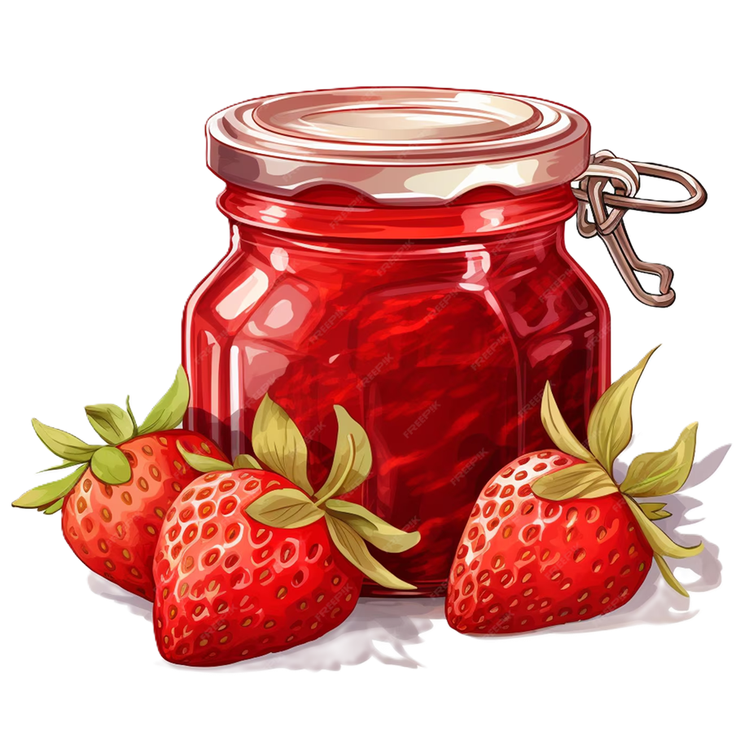
J –ज
Jug
Jam
kidslearnwithconcept.in

Slide 12


K –क
kit
kid
kidslearnwithconcept.in

Slide 13

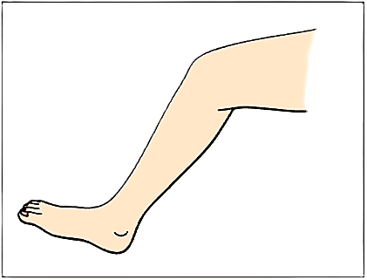
L –ल
Lab
Leg
kidslearnwithconcept.in

Slide 14


M –म
Man
Map
kidslearnwithconcept.in

Slide 15


N –न
Nut
Nap
kidslearnwithconcept.in

Slide 16

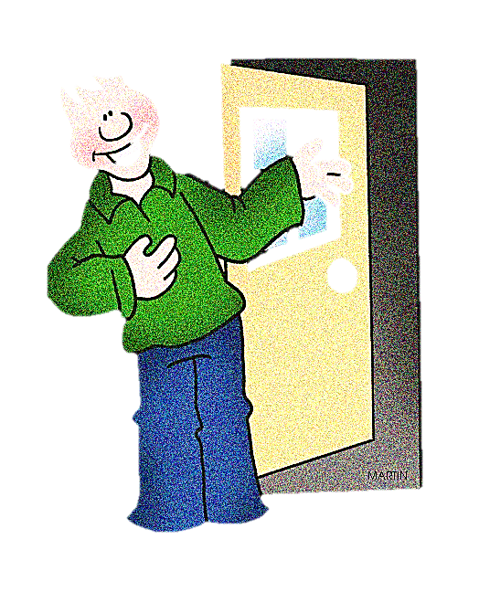
O –ओ
Owl
Out
kidslearnwithconcept.in

Slide 17


P –प
Pen
Pot
kidslearnwithconcept.in

Slide 18

Q– क्व -Queen
kidslearnwithconcept.in

Slide 19

R– र - Rabbit
kidslearnwithconcept.in

Slide 20

S– स - Sun
kidslearnwithconcept.in

Slide 21

T– ट - Tomato
kidslearnwithconcept.in

Slide 22

U–अ-umbrella
kidslearnwithconcept.in

Slide 23

V– व -Van
kidslearnwithconcept.in

Slide 24

W– व -Watch
kidslearnwithconcept.in

Slide 25

X– क्स - Xray
kidslearnwithconcept.in

Slide 26

Y– य - yoyo
kidslearnwithconcept.in

Slide 27

Z– ज़ - Zip
kidslearnwithconcept.in

Slide 28

Thank you🙏
kidslearnwithconcept.in

