Slide 1
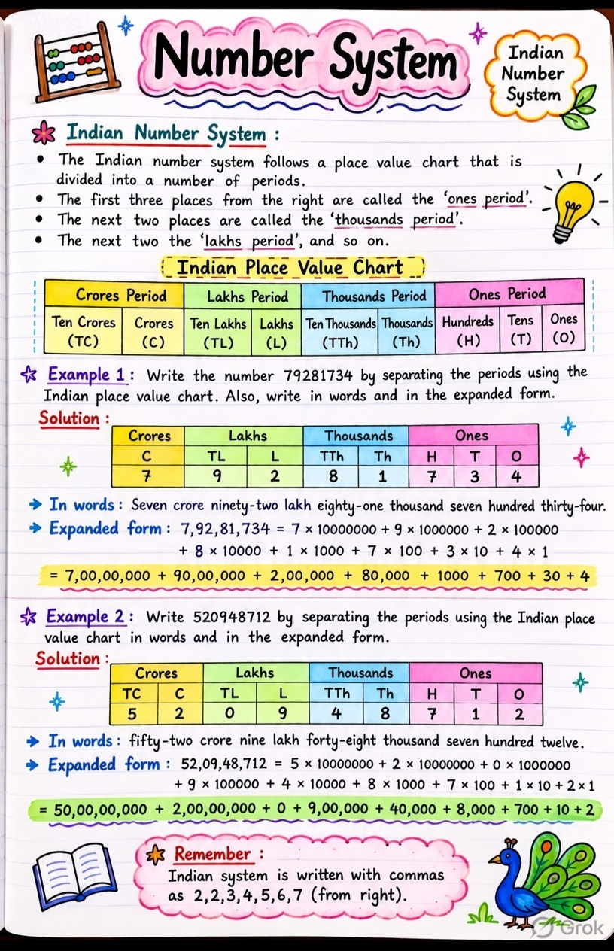

kidslearnwithconcept.in

