Slide 1
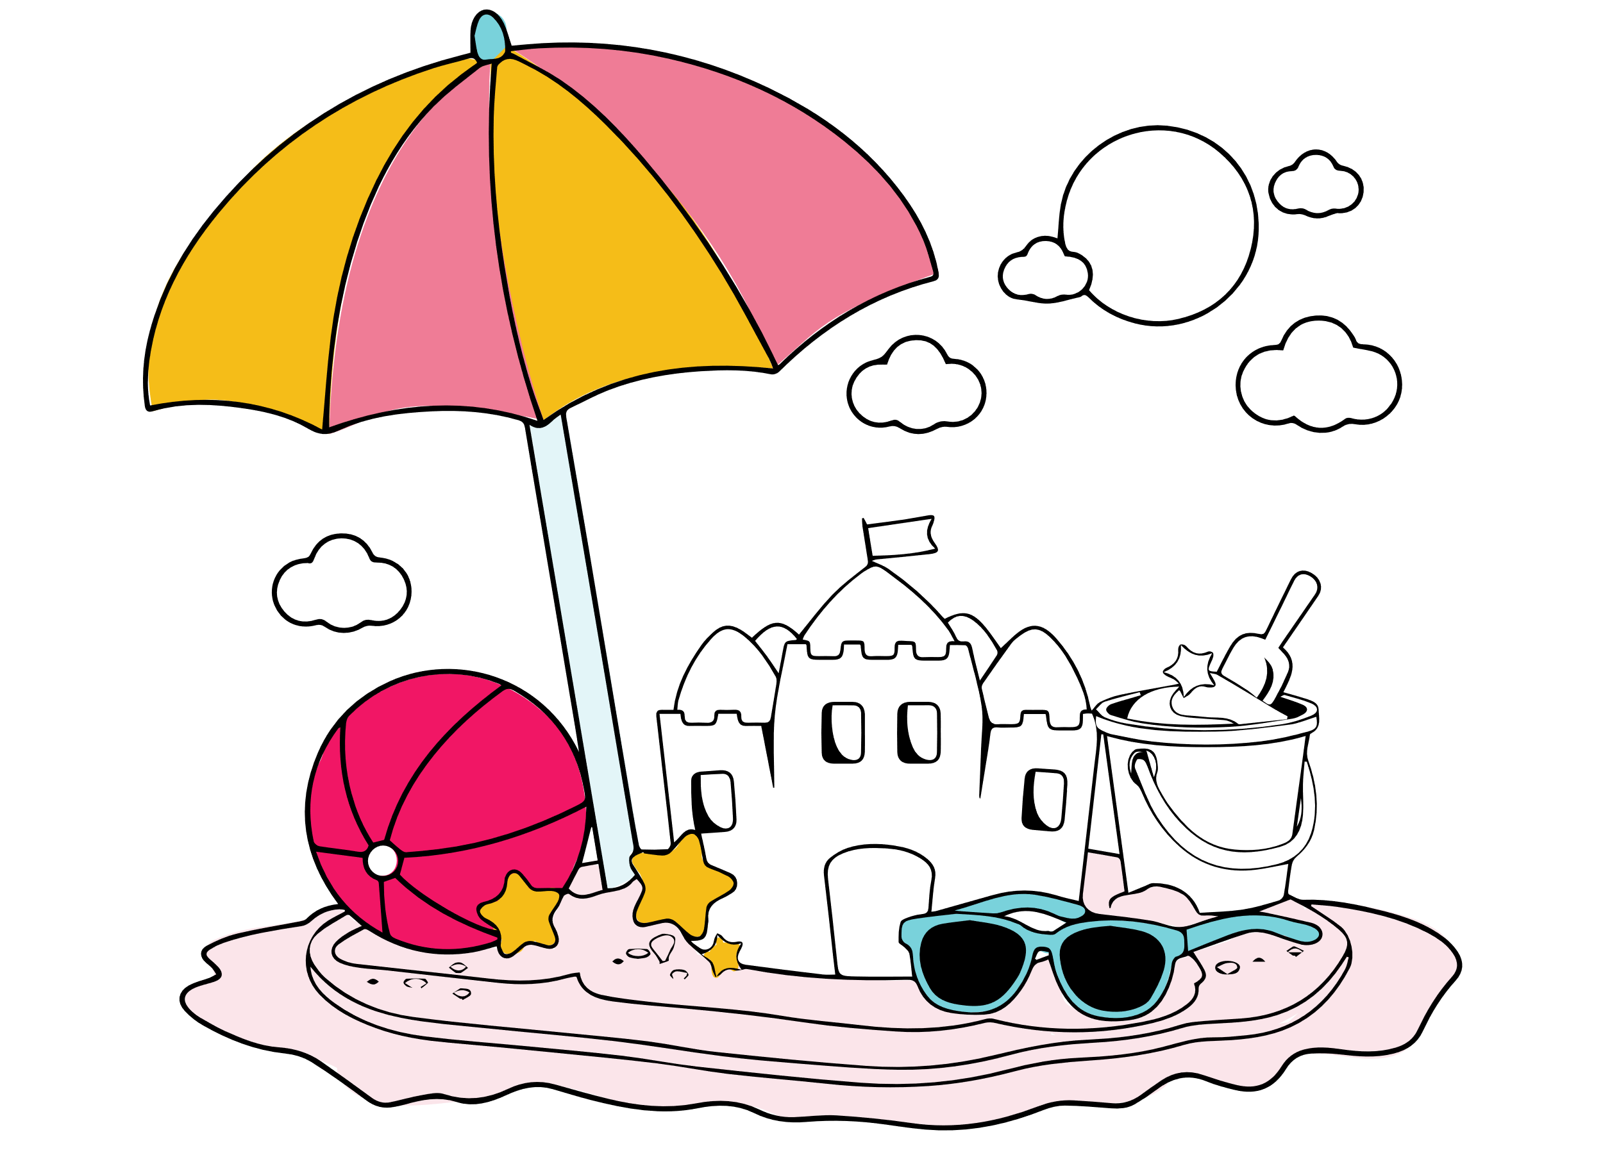

Cover page
SUMMER
VACATION
kidslearnwithconcept.in

Slide 2
1) Summer vacation is the holiday period during the summer season.
2) It is the best time of the year.
3) Summer Vacation lasts from May to June.
4) All school are closed in summer vacation.
5) Children feel very happy during summer vacation.
6) It is a period of rest and freedom from study.
7) Most of the children visit their grandparents in summer vacation.
8) Grandparent tells stories at night time.
9) We play cricket and hide-and-seek every day.
10)We eat mangoes and ice-cream in hot day.
11)Many children go for the summer camp.
12)Hot sun shines very bright outside.
13)We go for a small trip.
14)Summer Vacation is a chance to learn new things.
15) I like summer Vacation very much.
kidslearnwithconcept.in

Slide 3
Thank you
kidslearnwithconcept.in

