Slide 1
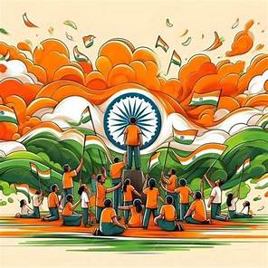

Essay on independence day
kidslearnwithconcept.in

Slide 2
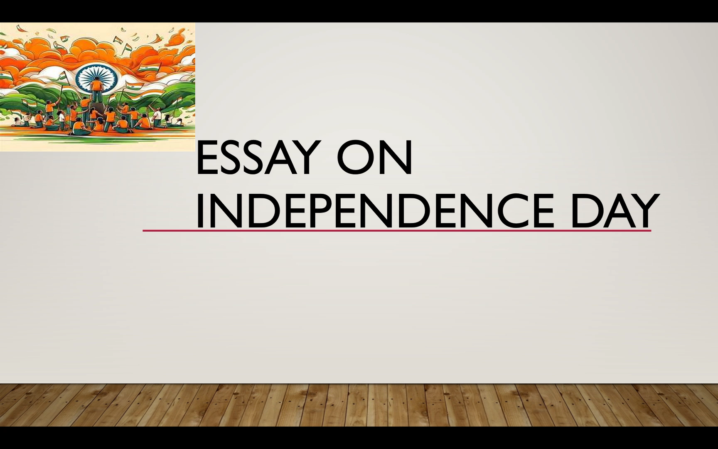
Good morning everyone, respected principal , teachers and all my dear friends . Today I am standing Infront of you to deliver speech on independence day . Before moving forward, I would like to with you all who are present here a very “happy independence day”.
Today is a historic day in the history of our country. on this day 15th August 1947 we got independence from the British. This day remind us of our true worth and importance as freedom - loving brave Nation. The freedom that we are enjoying today is the result of decades - long struggle made by our forefather and our great leaders.
kidslearnwithconcept.in

Slide 3
Great freedom fighters like Mahatma Gandhi, Bhagat Singh, Subhash Chandra Bose, Lala Lajpat Rai, Rani Laxmi Bai, Bal Gangadhar Tilak and many others devoted their entire life for the Independence of our country. Their sacrifice can never be forgotten.
We are fortunate that we are born in an independent country and we have our own fundamental rights. Today we have the right to choose our government.
Since Independence are country has developed in many areas but there is still lot of be done and achieved. It is our duty to stand up to these expectations and fulfill the dreams of a developed and successful country with peace and harmony.
kidslearnwithconcept.in

Slide 4
Thank you
जय हिंद
kidslearnwithconcept.in

