Slide 1

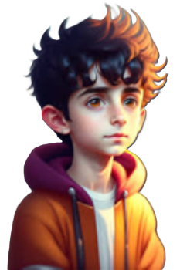
MYSELF
25 lines on myself
kidslearnwithconcept.in

Slide 2
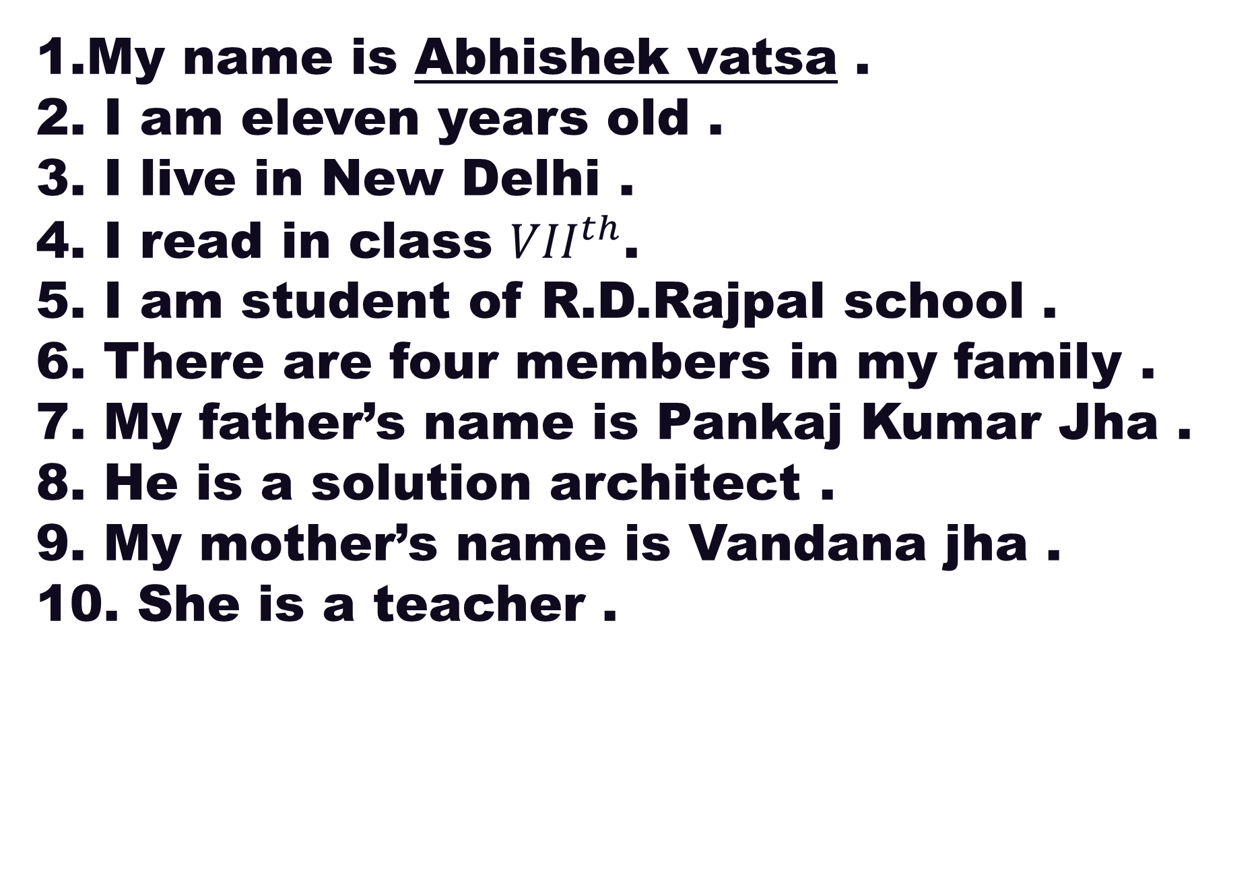
My name is Abhishek vatsa .
2. I am eleven years old .
3. I live in New Delhi .
4. I read in class ${VII}^{th}$.
5. I am student of R.D.Rajpal school .
6. There are four members in my family .
7. My father’s name is Pankaj Kumar Jha .
8. He is a solution architect .
9. My mother’s name is Vandana jha .
10. She is a teacher .
kidslearnwithconcept.in

Slide 3

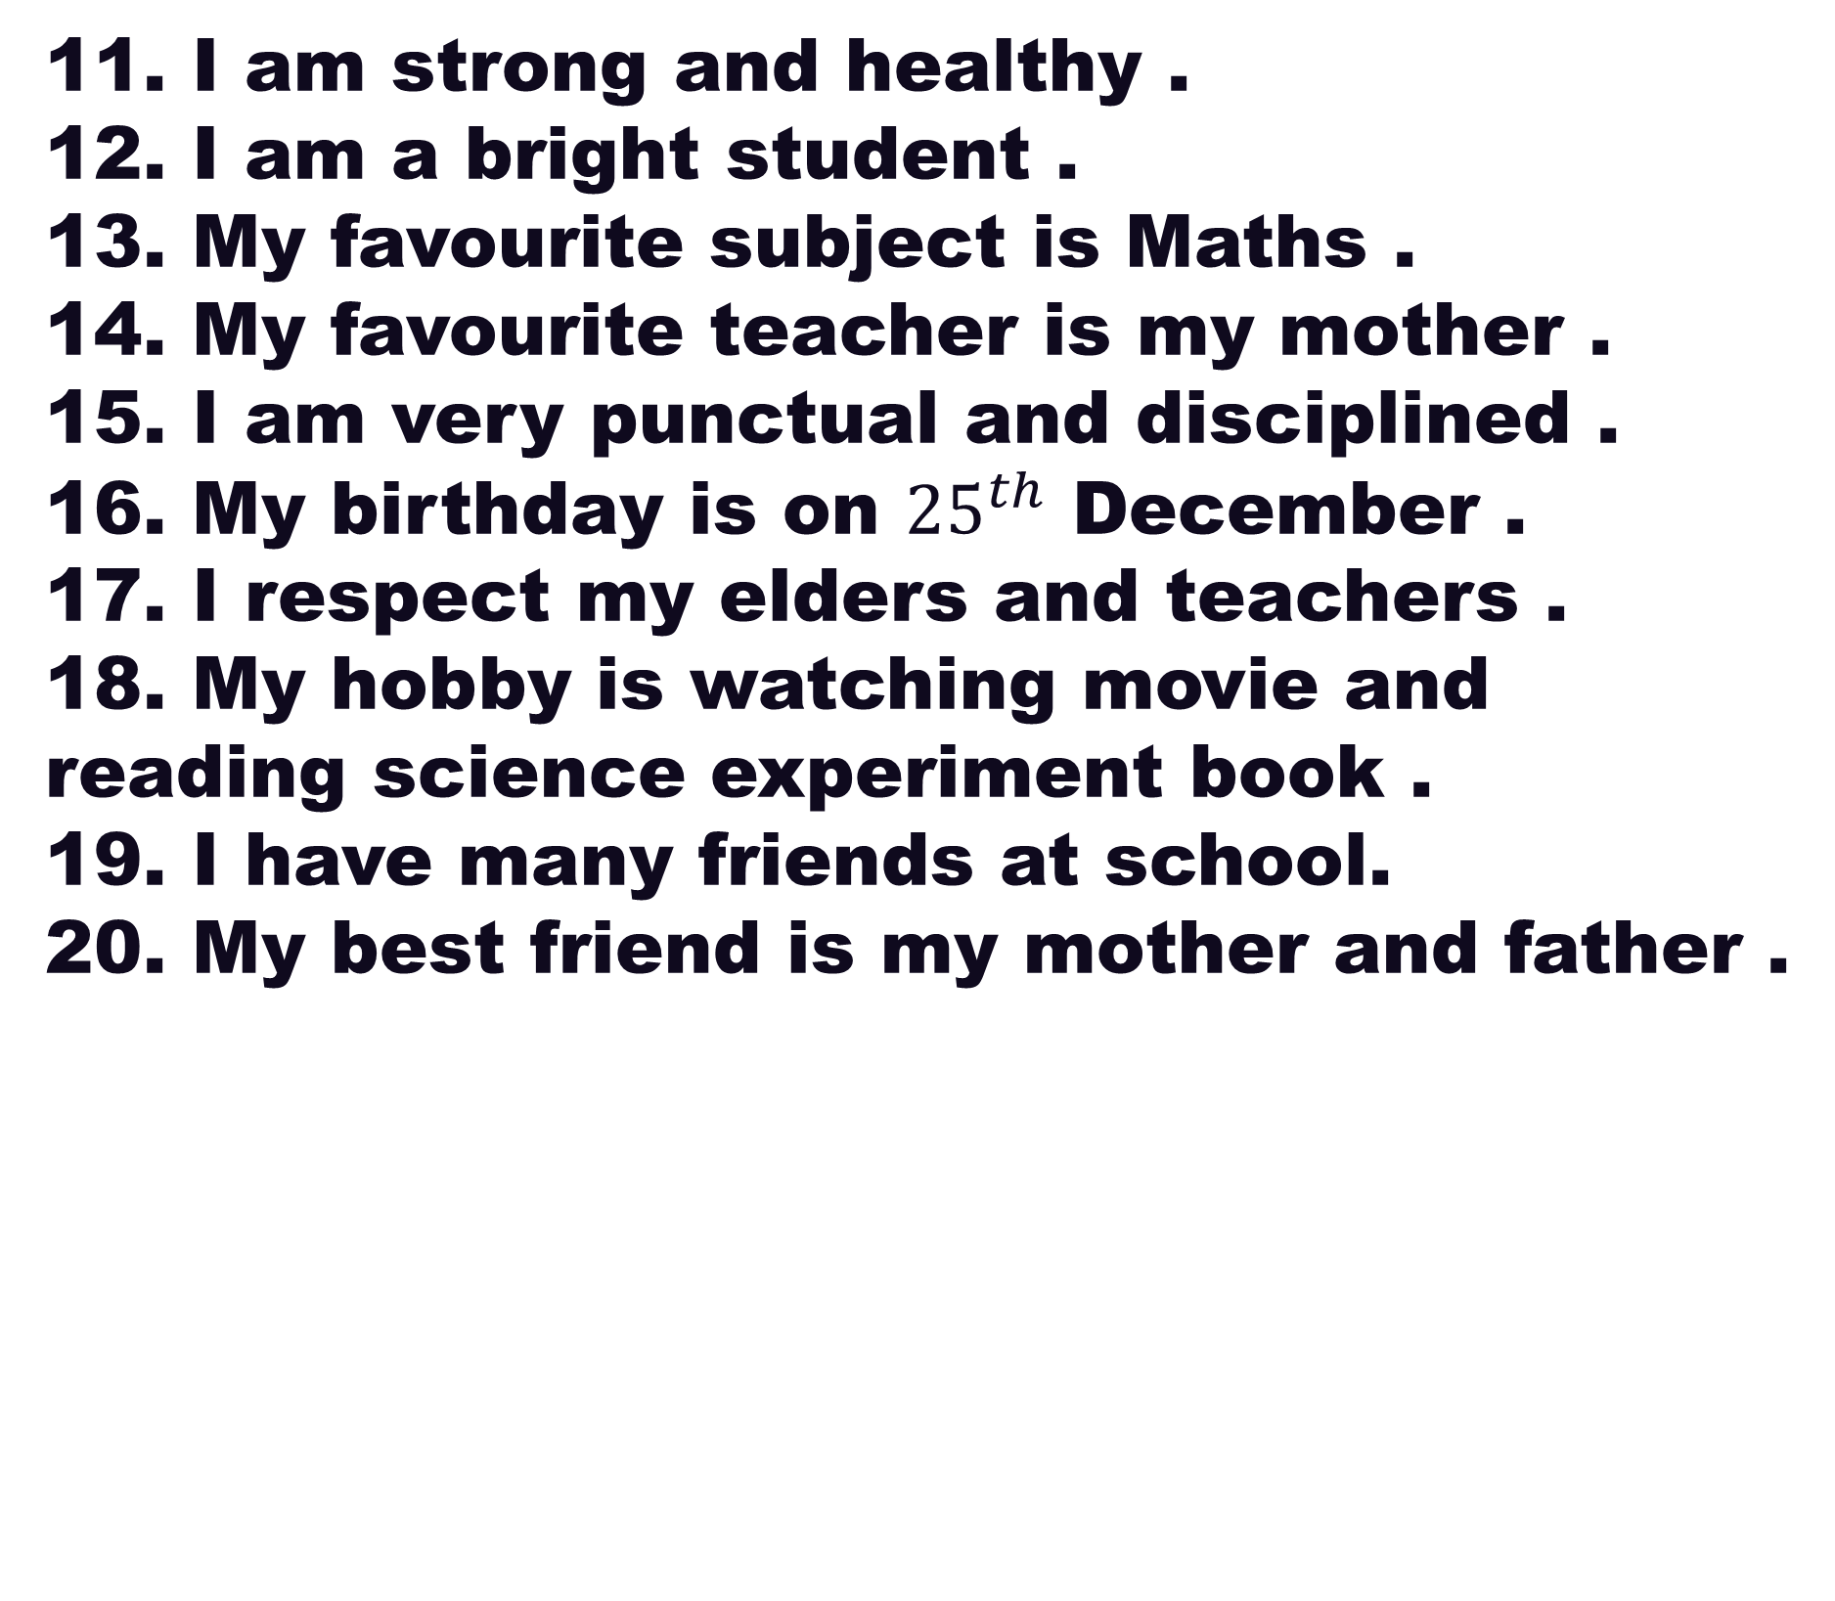
11. I am strong and healthy .
12. I am a bright student .
13. My favourite subject is Maths .
14. My favourite teacher is my mother .
15. I am very punctual and disciplined .
16. My birthday is on ${25}^{th}$ December .
17. I respect my elders and teachers .
18. My hobby is watching movie and reading science experiment book .
19. I have many friends at school.
20. My best friend is my mother and father .
kidslearnwithconcept.in

Slide 4
21. My favourite game is cricket .
22. My mother tongue is Maithili .
I am very hard working .
My strength is my family .
I want to be a chip designer .
kidslearnwithconcept.in

Slide 5
Thank you
kidslearnwithconcept.in

